Slide 1

Portfolio
Assessment T1A2
mkmotschmann.netlify.app
By Maximilian K. Motschmann

Slide 2
Index
Sitemap
Wireframes (Mobile, Tablet & Desktop)
Colours
Mobile Layout
Tablet Layout
Desktop Layout
Challenges

Slide 3
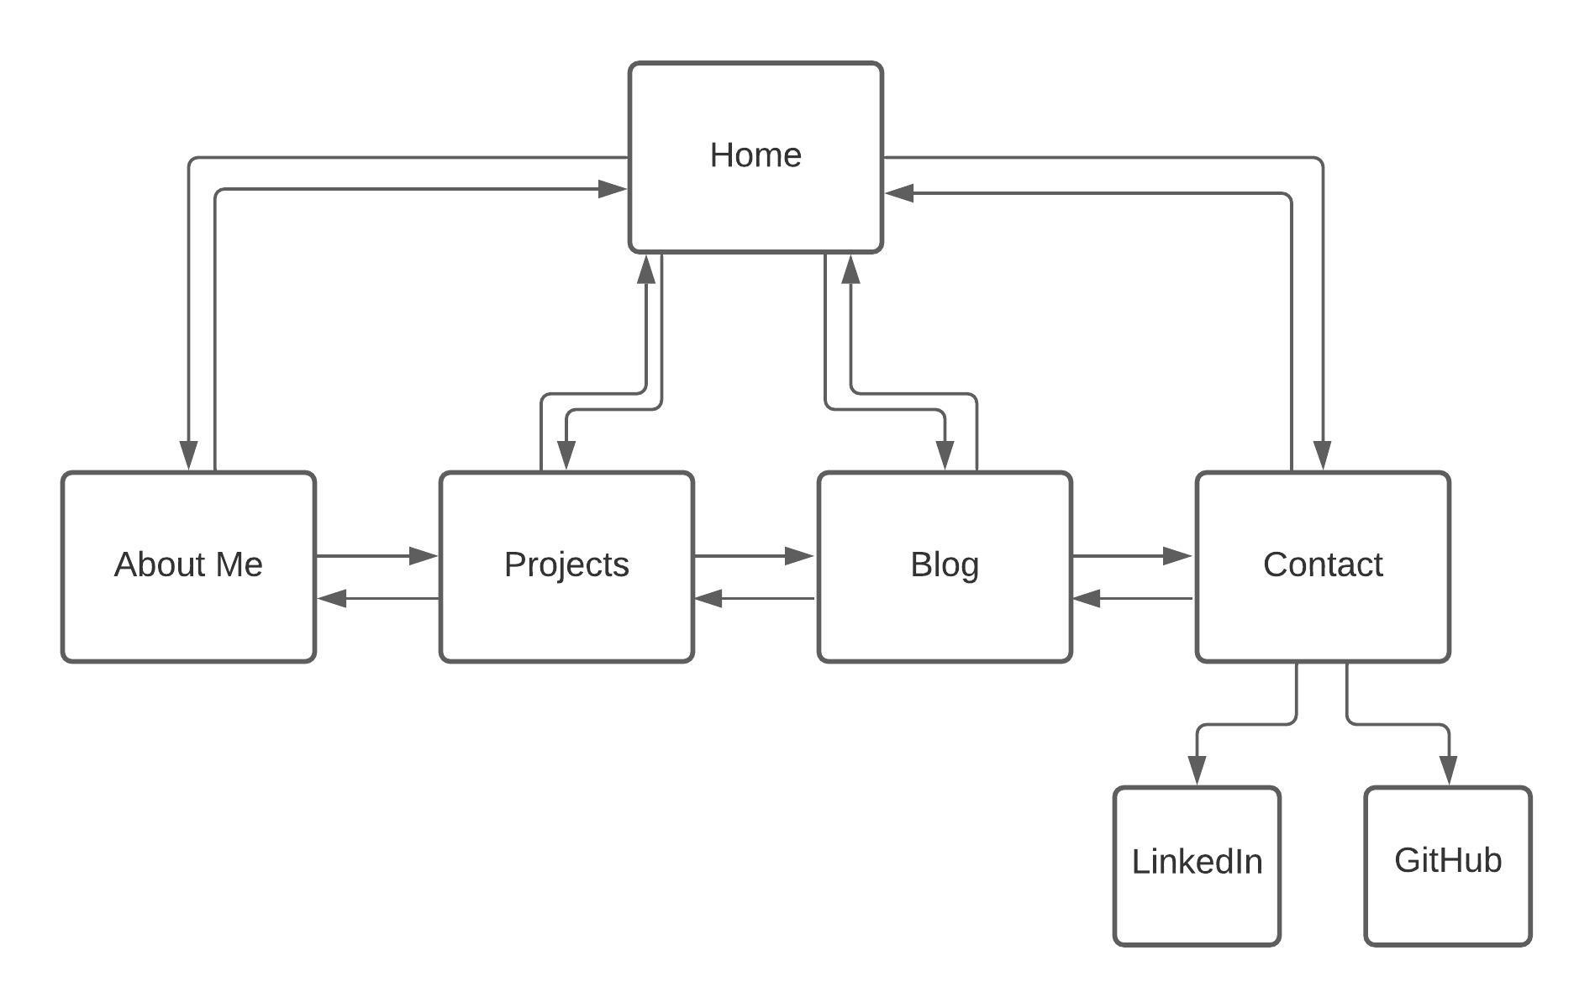
Sitemap

Slide 4
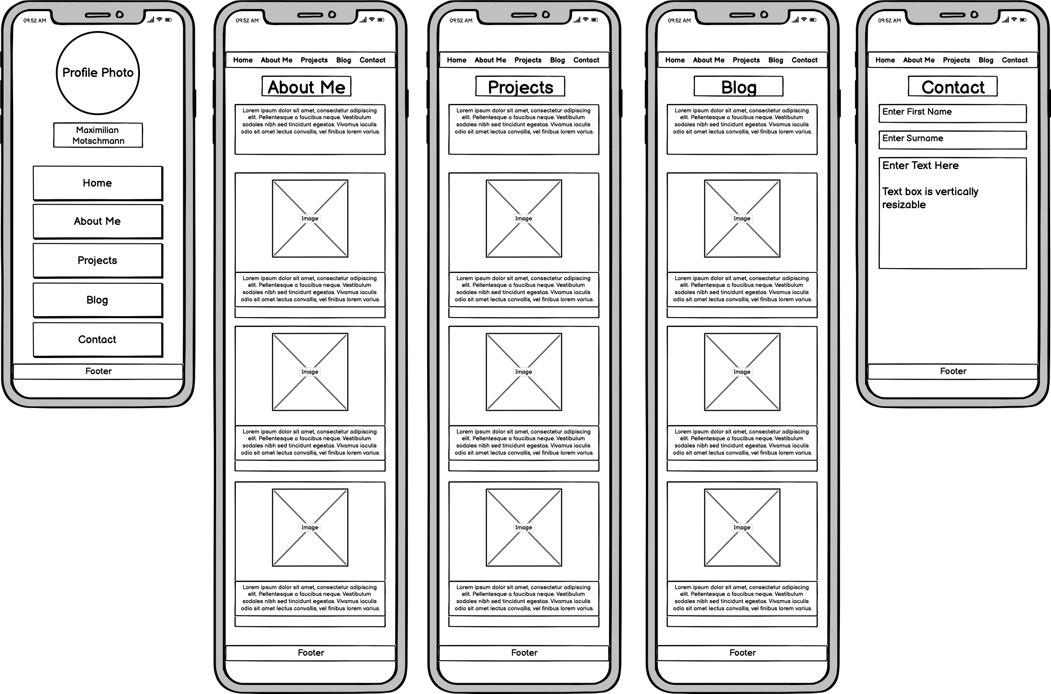
Wireframes
Mobile Layout

Slide 5
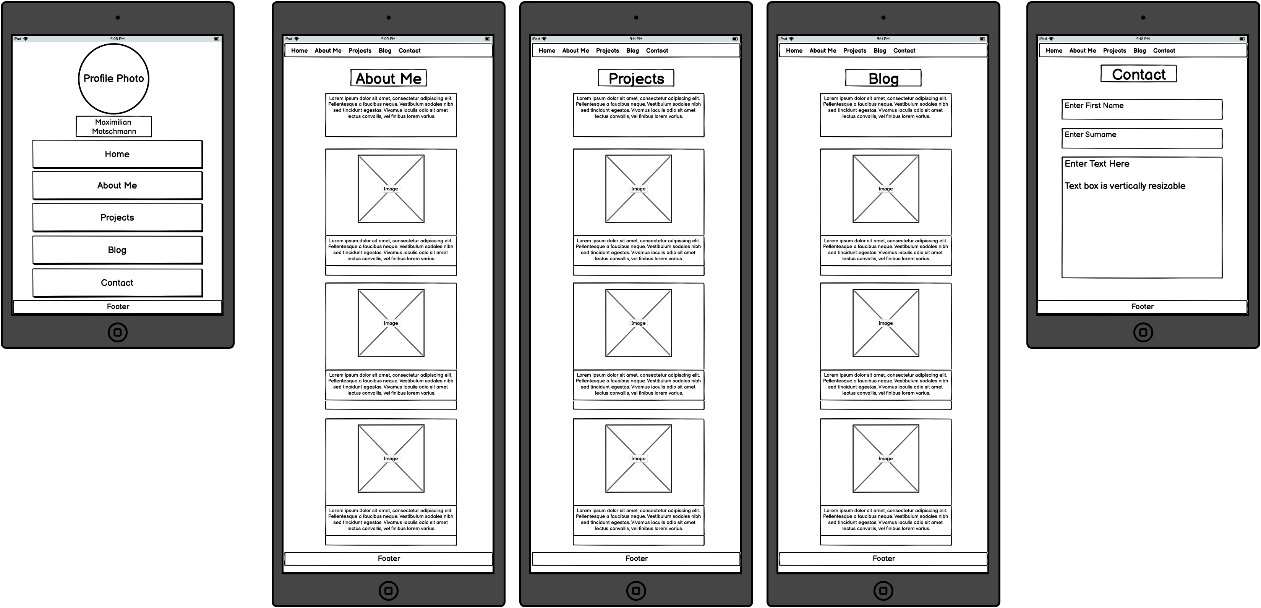
Tablet Layout

Slide 6
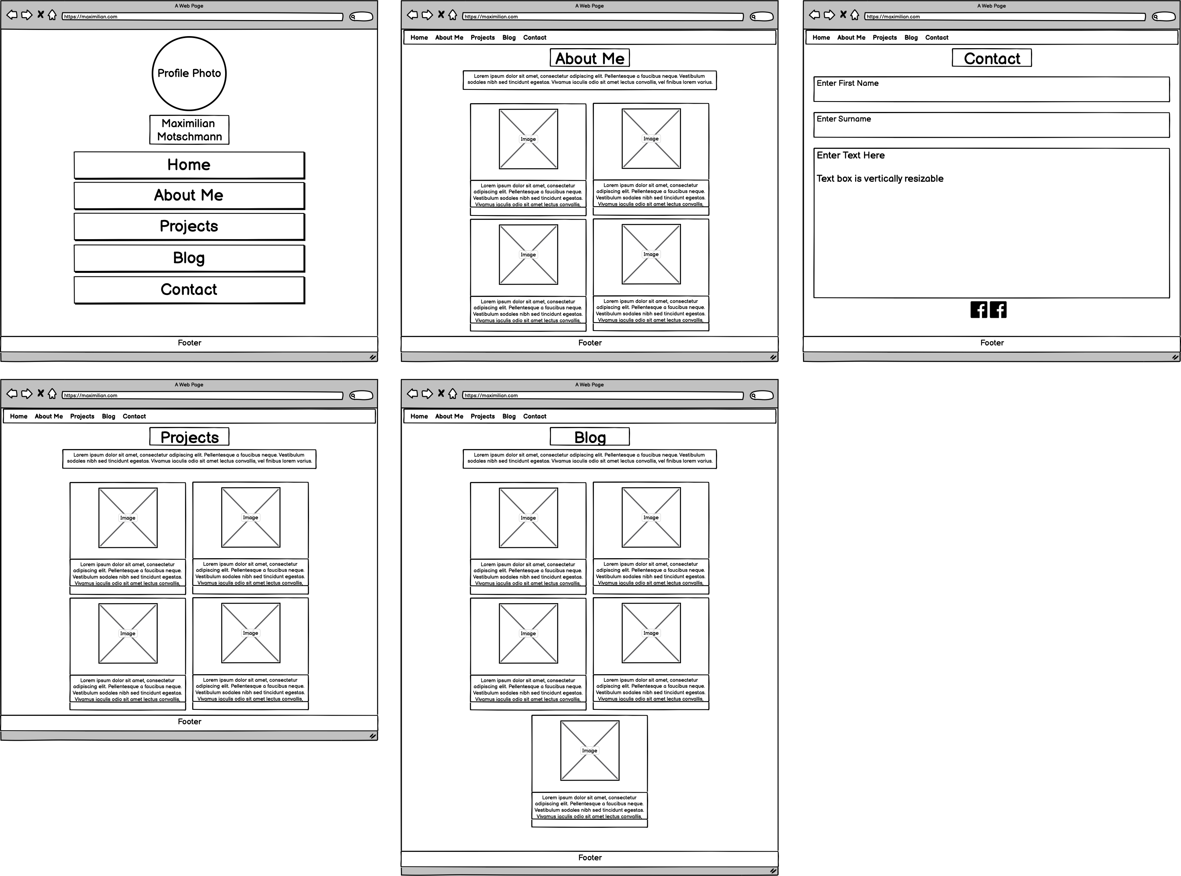
Desktop Layout

Slide 7
Colours
Headings:
Black: #1C1C1C
Paragraphs, Visited Links, Buttons:
Various Greys:
#696969, #808080, #C0C0C0, #D3D3D3, #DADDD8, #F2F2F2
Links
Blue: #0000FF
Content boxes:
Light Greyish Yellow: #ecebe4
Footer text:
White: #FFFFFF

Slide 8
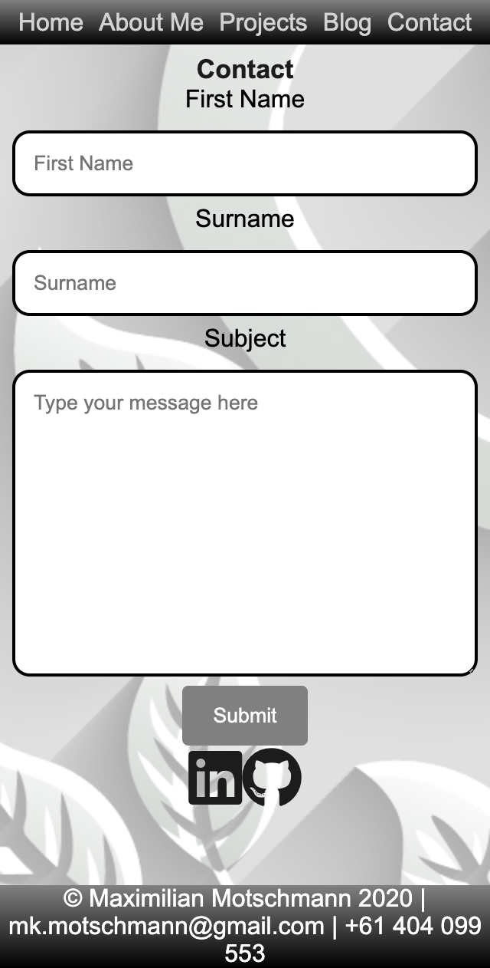
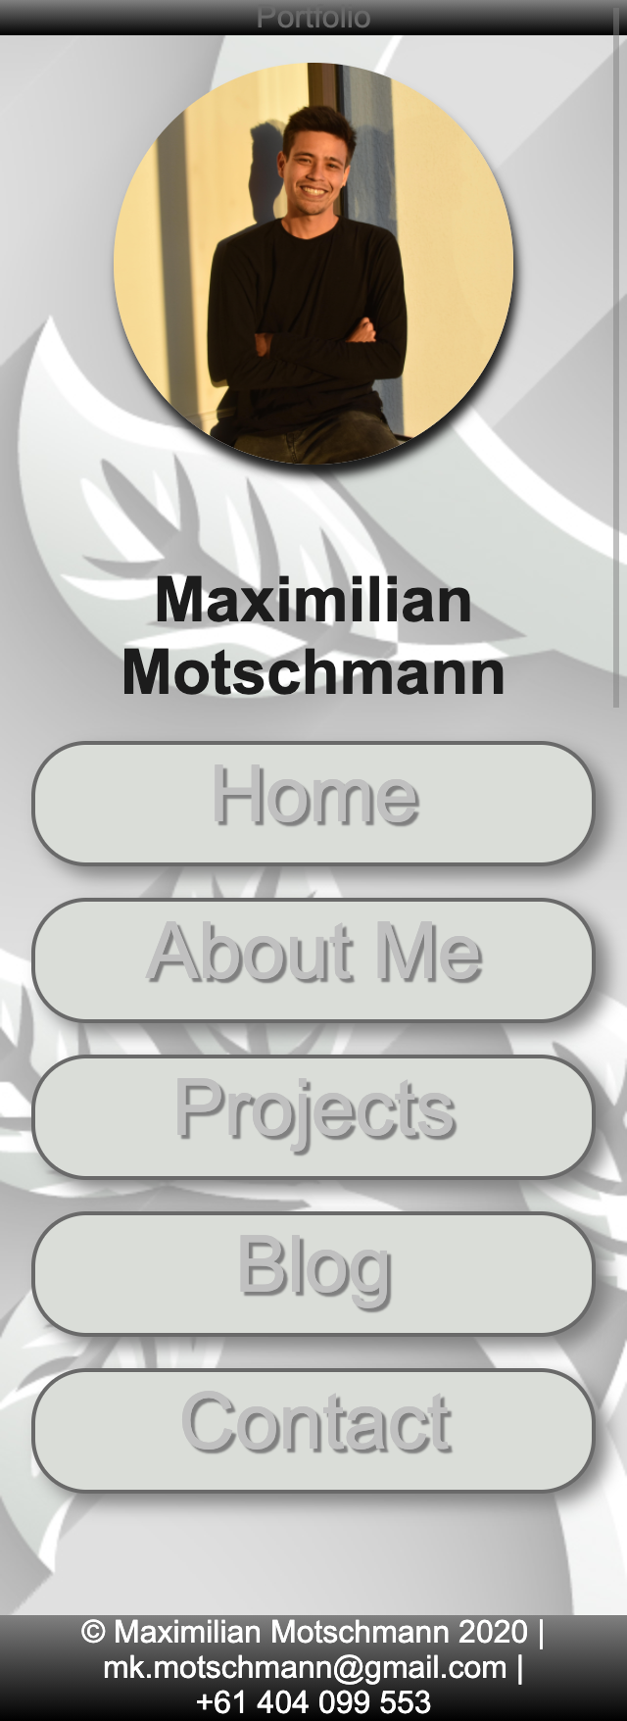
Mobile Layout – Landing Page
Contact Page
- First Name
and Surname
- LinkedIn & GitHub link
Landing Page
Profile photo
Buttons
Header and Footer

Slide 9
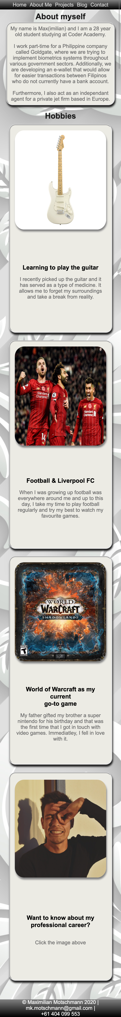
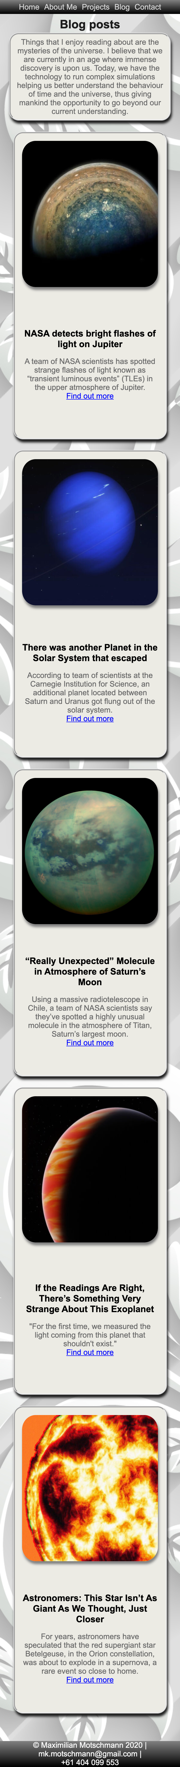
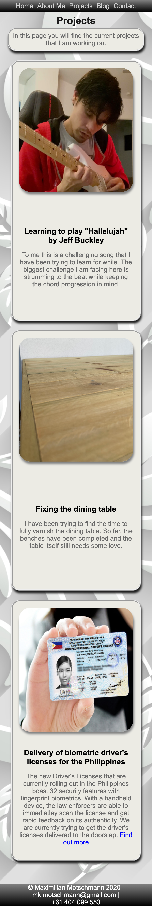
About Me Projects Blog
The pages share a similar design.
Navigation Bar has moved to top.
Headings scale depending on viewport
Border-style: ridge;
Shading.
Rounded edges for each box and image.

Slide 10
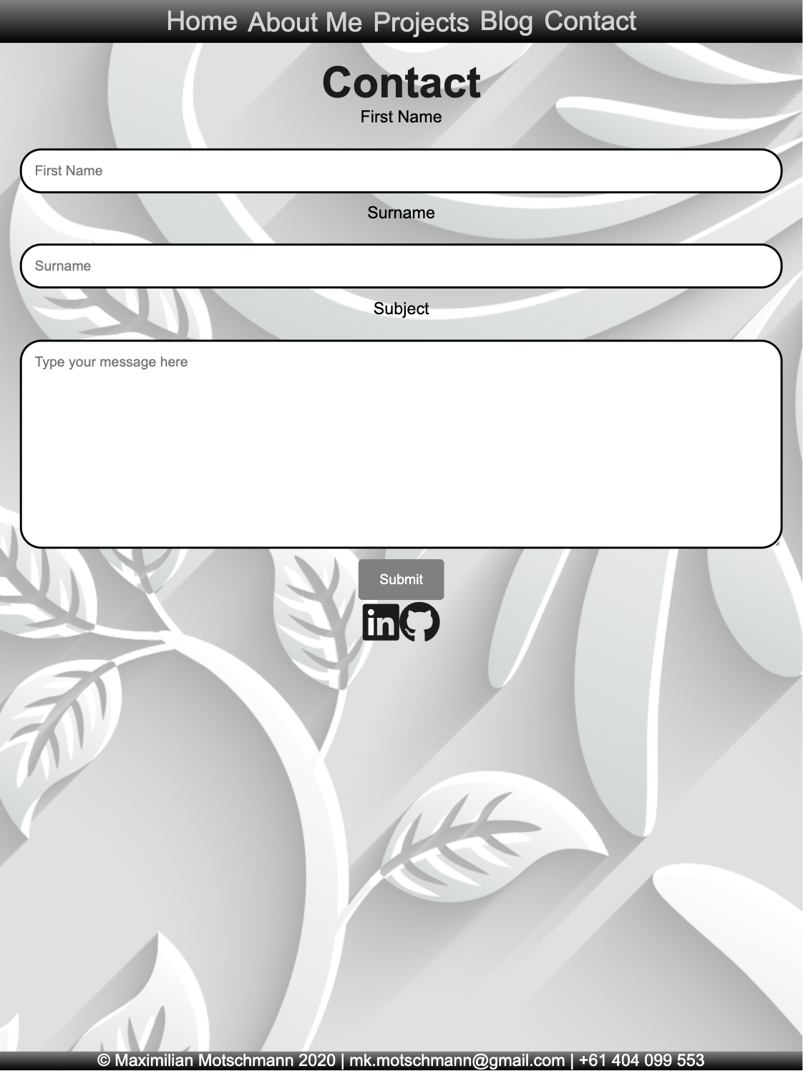
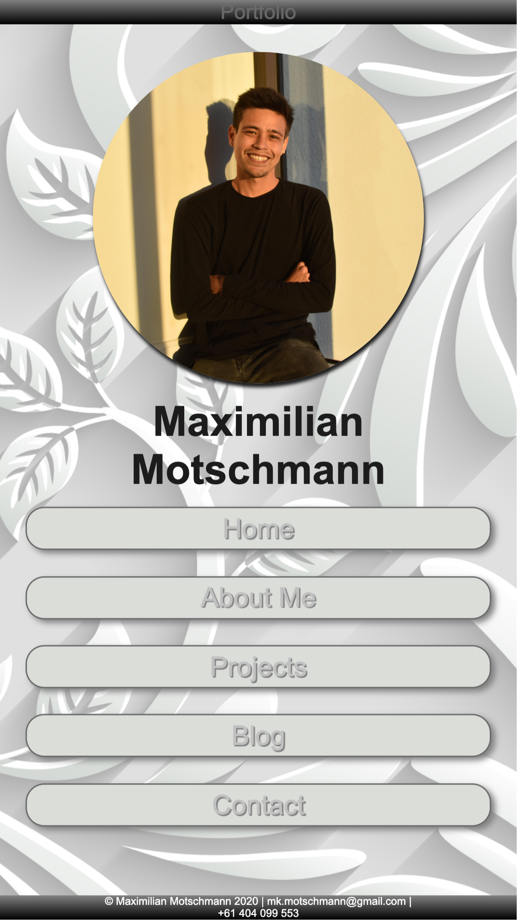
Tablet Layout – Landing Page
- Heading scales with resolution.
- Profile image scales
- Margin between buttons increase.
Changes made:
Reduced the margin between the profile photo and my name
Centered button text

Slide 11
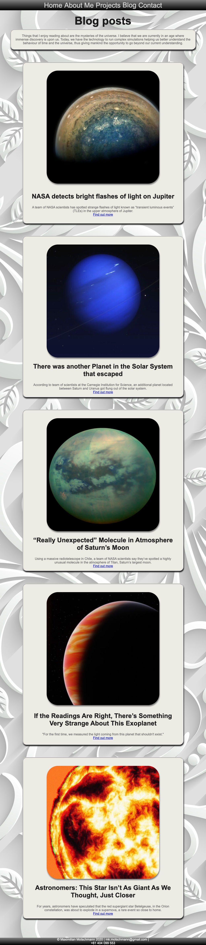
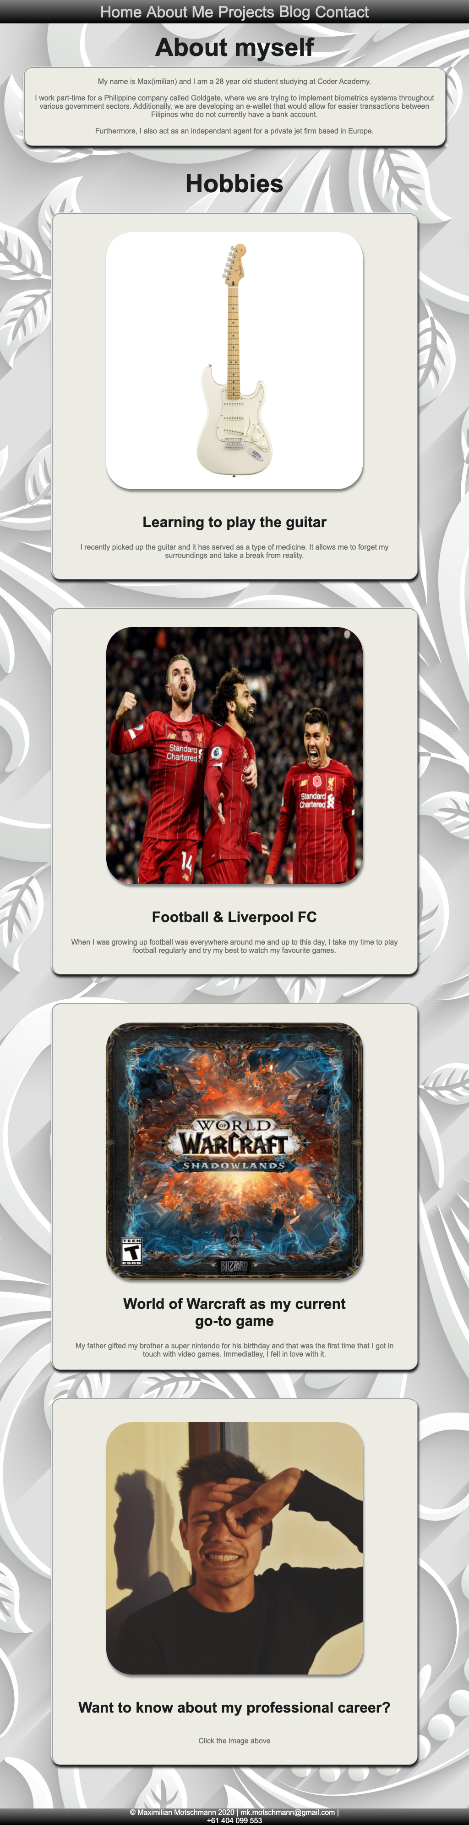
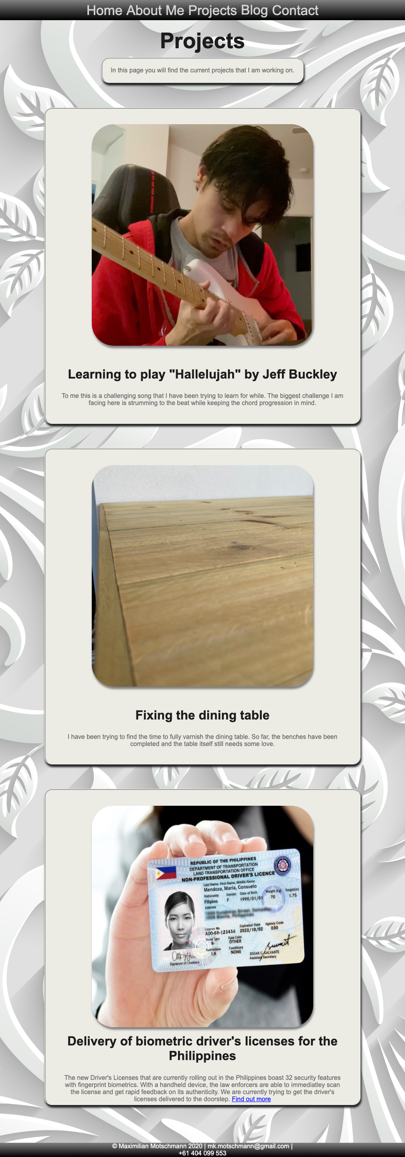
About Me Blog Posts Projects
Boxes have a max-width & height.
Changes made:
Went back to the mobile code and changed the box height, because the text was spilling.
Navigation bar was positioned on the left and had to be centered for Tablet view

Slide 12
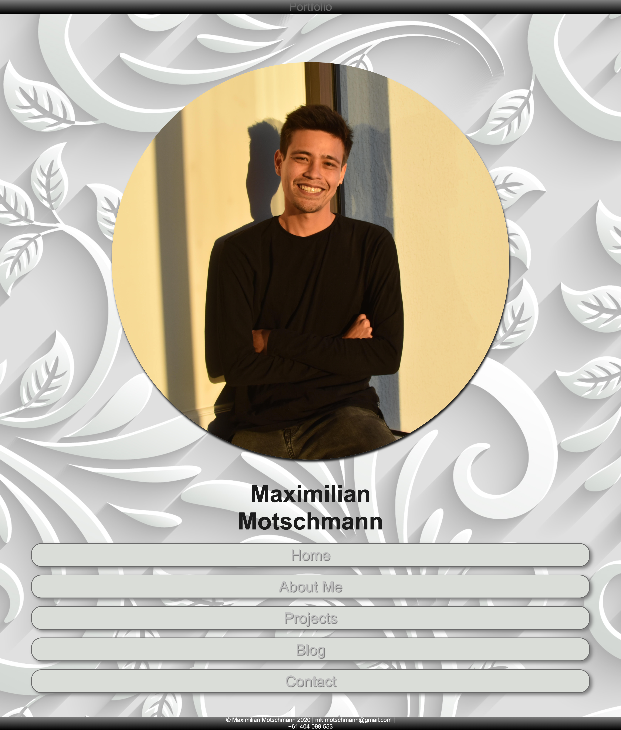
Desktop Layout – Landing page
- Image scales to max-width and height.
Changes made:
Aligned and centered the button text to the button.
Further reduced the margin between Profile Image and my name.

Slide 13
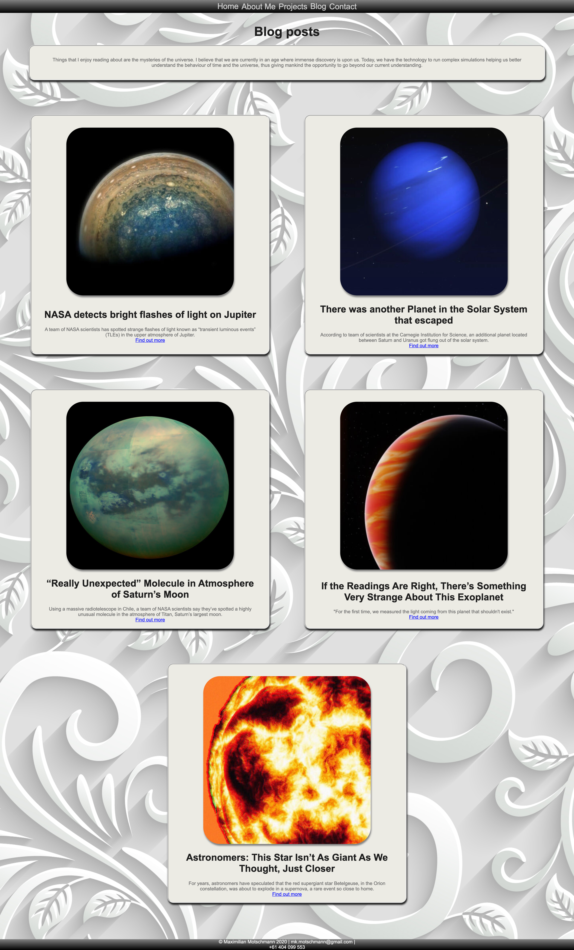
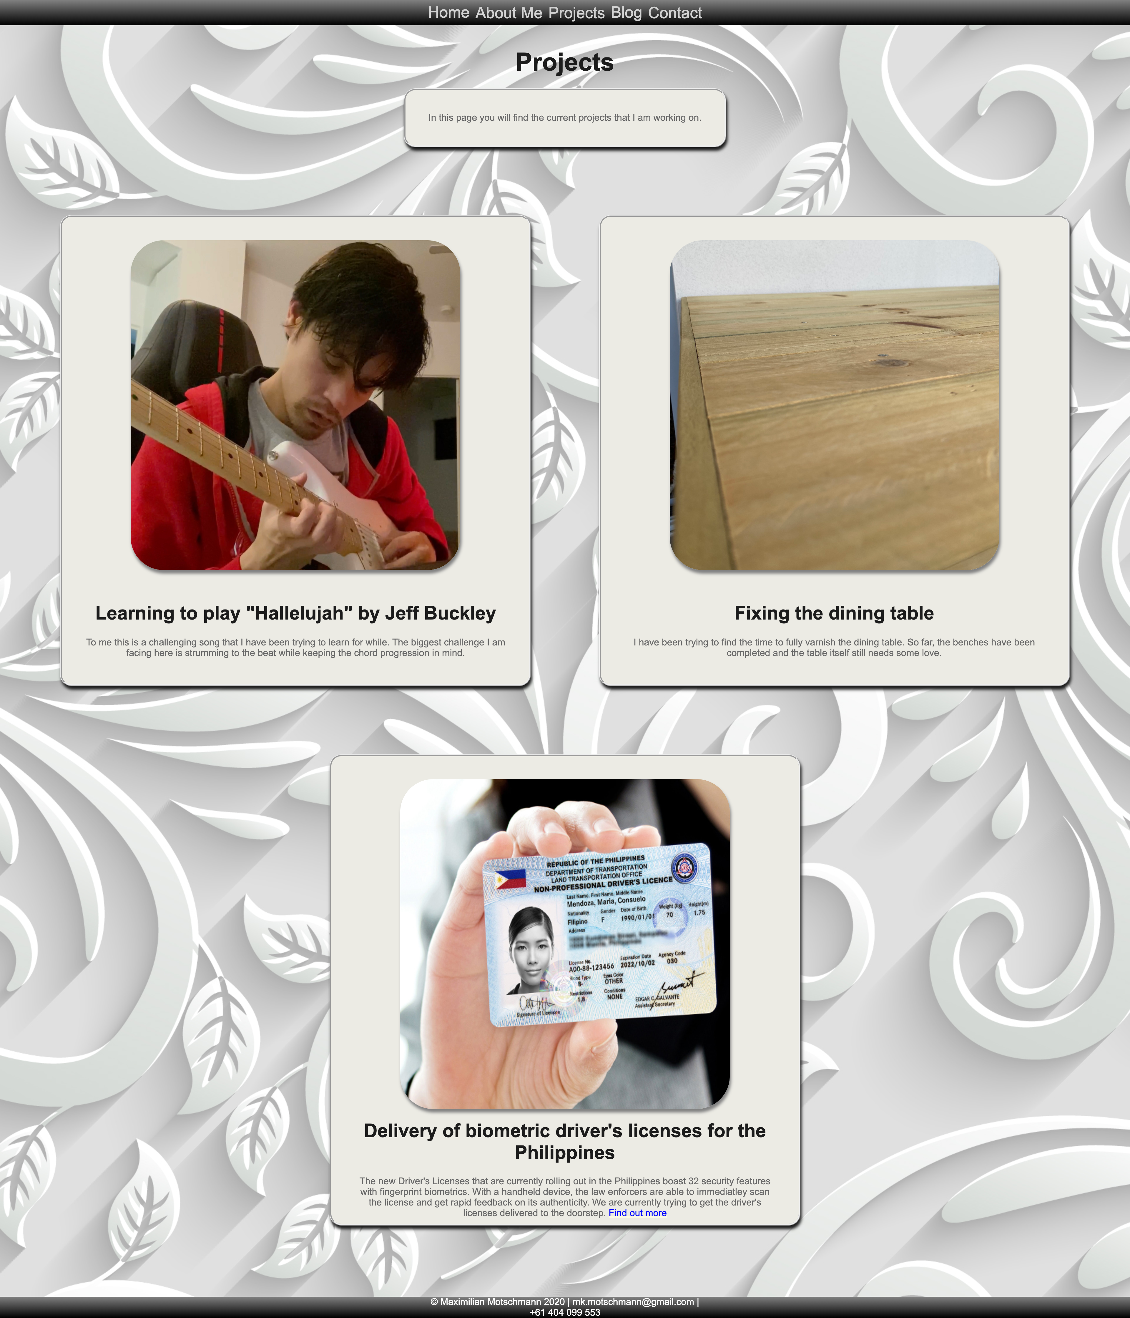
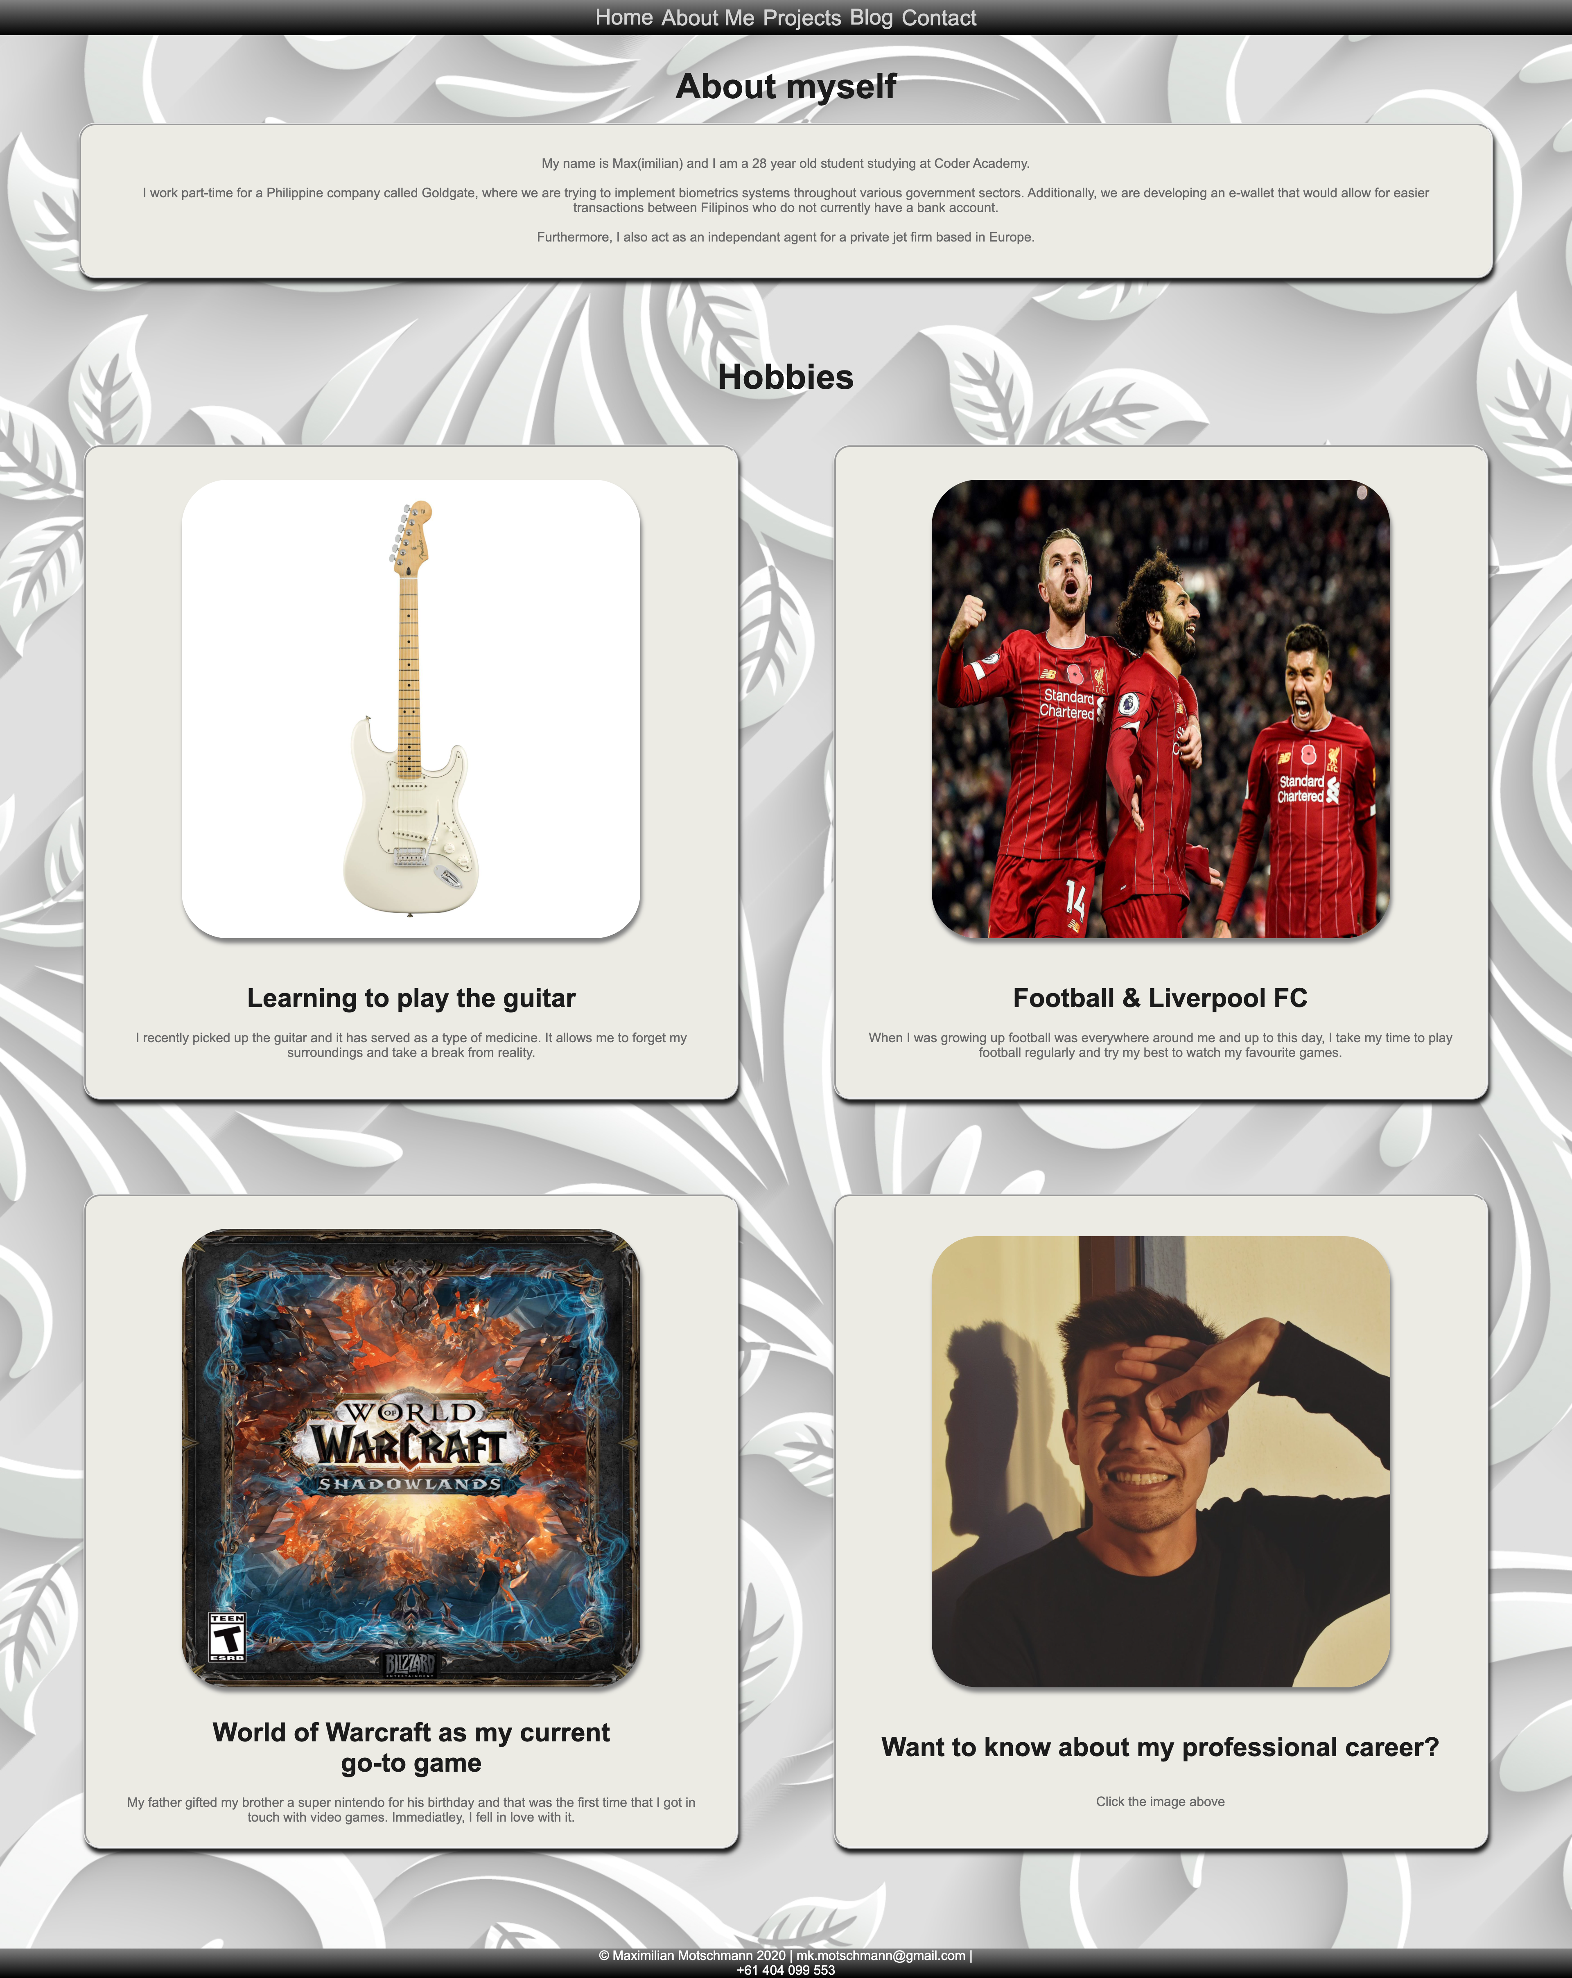
About Me Projects Blog
- Top box in each of the pages shares a max- width.
- The boxes wrap around with the help of flex- wrap.
Changes Made:
- None

Slide 14

Challenges
- Getting a satisfactory design
- Picking the right colours
- Getting the footer to stay at the bottom
- Getting the profile picture centered and my name
- Keeping the code organized
- Reviewing the code

